Slide 1


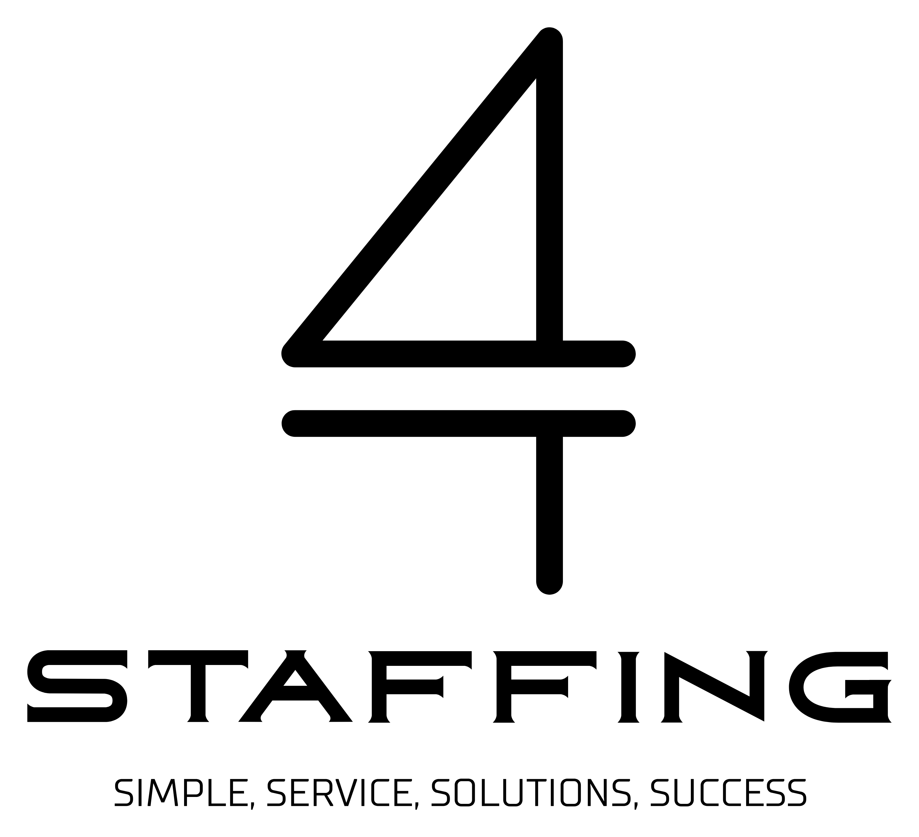
4 Staffing Corp
1

Slide 2


Our Expertise
Specialized Tech Recruiting
AI & Machine Learning
Data Science
Cloud Engineering
Cybersecurity
ERP/CRM
Sales Leadership
4 Staffing Corp | www.4staffing.net/index.php/our-specialties
3

Slide 3
Our Solutions
Contingency Placements
Agile Sprint Sourcing
Best for a limited number of targeted roles
Filling critical skill gaps
No cost until a successful hire
20% competitive fee
Best for multiple hires
Dedicated recruiting teams
(6–8) week turnaround
Save up to 40% compared to contingency
4 Staffing Corp | www.4staffing.net/index.php/solutions
4

Slide 4


We
Why Choose 4 Staffing?
Proven Track Record
Flexible Solutions
20+ years of nationwide recruiting experience.
Contract, temp, temp-to-perm, contingency, RPO & retained search.
Speed & Agility
Partnership Approach
Faster placements via our agile sprint method.
True partnership, built for long-term success.
We give back
Delaware Established – No Tax
A portion of our fee is donated to a charity of your
choice.
Our Delaware incorporation means no additional
taxes passed to clients for our services.
4 Staffing Corp | www.4staffing.net
5

Slide 5




Our Process
Discovery Call
Talent Research
Learn your needs, culture, and role requirements
Sourcing from our network of pre-qualified candidates
Candidate Presentation
Rapid Placement
Candidates matched to your team and culture
Most roles filled in 6–8 weeks
☷
Real-Time Visibility
Track every candidate in your personal Kanban dashboard, updated in real time
4 Staffing Corp
6

Slide 6

Client Success Story
"It was a testament to the power of collaboration, insight, and strategic partnership."
— Dan Albani, IT & Sales TA Leader
A Federal Consulting client had a critical position vacant for over a year, stalling key operations and project timelines.
4 Staffing stepped in and, through our specialized approach, successfully placed a highly qualified candidate in just 3 weeks.
4 Staffing Corp
7

Slide 7
Additional Services
Recruitment Process Outsourcing (RPO)
Retained Search
High-touch search for executive and leadership roles
End-to-end recruiting so your team can focus on
growth
Contract & Temp Staffing
Temp-to-Perm
Scale up or down with no long-term commitment
Try before you hire — reduce risk permanently
4 Staffing Corp | www.4staffing.net/index.php/solutions
8

Slide 8

Ready to Transform Your Talent Strategy?
Ready to build your dream team? Let’s talk. We’d love to learn about your hiring needs.
Email
Phone
Website
contact@4staffing.net
1-888-324-STAF (7823)
www.4staffing.net
4 Staffing Corp
9

